Slide 1
Advanced C++
Chapter 17 - Files
Fall 2011
Kristina Shroyer

Slide 2
Objectives
In this chapter you will learn how to:
  To create, read, write and update files.
  Sequential file processing.
  Random-access file processing.
  To use high-performance unformatted I/O operations.
  The differences between formatted-data and raw-data file processing.
  To build a transaction-processing program using random-access file processing.

Slide 3
Introduction to Files
First we’ll go over the very basics of using files
  If you already know files remember some people do not so please be quiet during lecture while we discuss it, we'll get to the processing stuff too!
Then we’ll go back and go into detail on each aspect files as well as get into more specific File Stream methods and issues regarding files

Slide 4
Files
Concept: A file is a collection of information, usually stored on the computer's disk. Information can be saved to files and later retrieved.
Files are crucial to real world programs
  Used for data persistence
    Permanent retention of large amounts of data
  Stored on secondary storage devices
    Magnetic disks
    Optical disks
    Tapes
Examples of familiar types of software packages that use files extensively are:
  Word Processors
  Database Management Systems
  Spreadsheets
  Compilers
    Compilers translate the source code of a program which is saved into a file, from the source file to an executable saved file.

Slide 5
File naming conventions
Each operating system has its own rules for naming files
  The system might allow long names such as:
    infoFrom1998
    corpSalesReport
    vehicleRegistrations
  Other Systems might only allow short file names
    MS-DOS allows filenames of no more than eight characters with an optional three character extension
Extensions are commonly used with filenames
  The name of the file and the extension are separated with a dot
  The filename indicates the file's purpose and the extension identifies the type of information contained in the files
    Example: .cpp for a C++ source code file
  Some extension examples:
    myprog.bas Basic file
    menu.bat Microsoft Windows Batch file
    install.doc Microsoft Word file
    crunch.exe Executable file
    bob.html HTML file
    model.java Java program or applet
    invent.obj object file
    readne.tax text file

Slide 6
Introduction to Files
Concept: Program input can be read from a file and program output can be written to a file
  Programs written so far require you to re-enter data each time a program runs
    This is because the data stored in RAM disappears once the program stops running or once the computer is shut down
  If a program is to retain data between the times it runs it must have a way of saving it
    Data is saved on a file which is usually stored on a computer’s disk
    By saving the data to a file it can be retrieved and used at a later time
So first we'll talk about
  How data is organized (Data Hierarchy)
  Simple Concepts about how to read and write sequential files

Slide 7
The Data Hierarchy
In this section of the book the author is basically trying to show you how data becomes a file
  How does it go from 0's and 1's into an organized file – what are the various "levels" of data
  The following list goes from the lowest level of the data hierarchy to the highest level
The data hierarchy is simply an organizational look at data in which data items become larger and more complex in structure as we progress from smaller units of data (bits), to characters (patterns of bits), to fields, to records, to larger data structures
  Some of the organization in the hierarchy is structured by the C++ language itself (bits and characters) and some you as the programmer must impose (fields and records)

Slide 8
The Data Hierarchy
Levels of data in the hierarchy (lowest to highest levels):
  Bits (“binary digits”)
    Can assume one of two values, 0 or 1
    Smallest data item that computers support
      Computer circuitry performs simple bit manipulations
      Ultimately all data items are composed of bits
    Programming with bit data is cumbersome, so let's move up the hierarchy
  Characters
    Include decimal digits, letters and special symbols (more convenient to program with!!!)
      Since computers can only process 1s and 0s every character on a particular computer is composed of bits (1s and 0s)
      chars are stored in bytes (8 bits) (usually they are one byte)
        computers process and manipulate the characters you use in your programs as patters of bits
      wchar_ts are stored in more than one byte
        wchar_t is a data type C++ provides to deal with chars that occupy more than one byte such as Unicode
    A character set is the set of all characters used on a particular computer

Slide 9
The Data Hierarchy
Levels of data in the hierarchy (lowest to highest levels:
  Fields
    A field is a group of characters that conveys some meaning
      A field is something you the programmer will create
        A field can be a data member in a class in C++
    Example: Uppercase and lowercase letters can represent a name
  Records
    A record is composed of several fields which together have a higher meaning
      Again this is something the programmer will create
    Think of a record as a group of related fields
    A record can be represented as a class (or a struct) in C++ and the data members in that class represent the fields the record is composed of
    Example:
      An employee’s record might include id#, name, address, etc.
        So each field is related to that employee, the employee is the class and the fields are the data members
      A record key is a field unique to each record (id# in our example could be a record key)

Slide 10
The Data Hierarchy
Levels of data in the hierarchy (lowest to highest levels:
  File
    A file is a group of related records
      This is the idea even though in reality a file could be arbitrary data in arbitrary formats – arbitrary is not very useful though – in some operating systems a file is viewed as nothing more than a collection of bytes, in these types of operating systems the organization of the file is created by the programmer
    Example: A payroll file containing one record for each employee
    Many ways to organize records in a file
      One way is as a sequential file
        A sequential file is one in which records are usually stored in order by record key field
    Records are stored in order by a record-key field
  Database
    Composed of a group of related files
    Managed by a collection of programs called a database management system (DBMS)

Slide 11
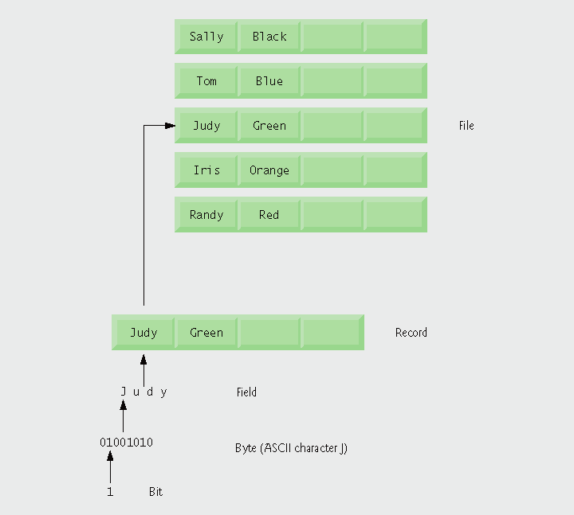
Data hierarchy Model

Slide 12

Files and Streams
Files
  Files are viewed by C++ as a sequence of bytes/bits (see diagram below)
    Each file ends either with an end-of-file marker or at a system-recorded byte number

Slide 13
Files and Streams
File Basics
Communication between a program and a file is performed through stream objects
  When a file is opened an object is created and a stream is associated with that object that provides communication channels between a program and a particular file or device
    Similar to how cout opened a communication channel between a program the standard output device,
<fstream> header file
  provides the definitions for the file stream class templates
    basic_ifstream – for file input
    basic_ofstream – for file output
    basic_fstream – for file input and output
  Files are opened by creating objects of stream template specializations
  Each class template has a predefined template specialization that enables char input/output
  Files are opened by creating objects of these stream template specializations
These templates (the ones above - basic_ifstream, basic_ofstream, and basic_fstream ) derive from: basic_istream, basic_ostream, and basic_iostream
  This means all member functions and operators that belong to istream, basic_ostream, and basic_iostream can be applied to our file stream class templates listed above

Slide 14
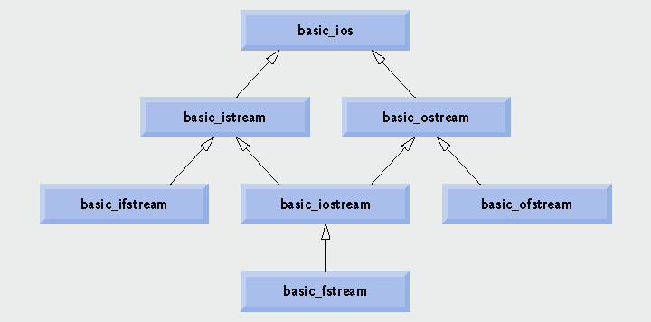
Portion of stream I/O template hierarchy.

Slide 15
Sequential Files: The Basics
File structure
  The programmer must structure files
    IMPORTANT: C++ does not impose structures on files
  We're going to start with a very simple structure
In general: Five Steps that must be taken when a file is used by a program:
  Include the header file needed to perform file input/output
  Define a file stream object
  Open the file
  Use the file
  Close the file

Slide 16
Sequential Files: The Basics
Step 1: Include the header file needed to perform file input/output
  The file fstream includes all of the declarations necessary for file operations
    The preprocessor statement needed:
      #include <fstream>
  You should note that fstream is a class data type
  You are going to be creating objects from the fstream class definition and using these objects’ methods to perform file input/output

Slide 17
Sequential Files: The Basics
Step 2: Define a file stream object
  The next step in setting up a program to perform file I/O is to define one or more file stream objects
    They are called stream objects because a file can be thought of a stream of data
      This is similar to with cin and cout
        A stream of data can be sent to cout causing data to be displayed on the screen (communication stream from program to standard output device)
        A stream of data can be read from the keyboard by cin and stored in variables (communication stream from standard input device to program)
      With file stream objects
        A stream of data can be sent to a file stream object which writes data to a file (communication between program and file – one way, data to file)
        A stream of data can be read from a file by a file stream object and stored into other variables (communication between program and file – one way, file to data)
        There is a file stream object that has two way communication

Slide 18
Sequential Files: The Basics
Step 2 cont.: Define a file stream object
  The fstream header file contains declarations for three types of file stream objects
    ofstream
    ifstream
    fstream
  Before a C++ program can work with a file it must define a file stream object of one of these data types (ofstream, ifstream, fstream)
    The object will be associated with an actual file stored on some secondary storage medium
    The operations that may be performed on the file will depend on which of the three types of file stream objects was created (is the communication one way, if so which way, or is the communication two way)
      In this basics section I’ll demonstrate the basics of using ofstream and ifstream, we’ll talk about fstream in more detail later

Slide 19
Sequential Files: The Basics
Step 2 cont.: Define a file stream object
FILE STREAM OBJECT | DESCRIPTION
ofstream | Output file stream. This file stream object can be used to open output files and write data to them. If the file does not exist yet, the open operation will automatically create it. If the file already exists, the open operation will destroy it and create a new empty file of the same name in its place if it is opened in ios::out mode With the ofstream data type data only may be copied from variables to a file, NOT vice versa.
ifstream | Input file stream. These data type can be used to open existing input files and read data from them into memory. With the ifstream data type data may only be copied from the file into variables, NOT vice versa.
fstream | File stream. This data type can be used to open files, write data to them, and read data from them. With the fstream data type, data may be copied from variables into a file OR from a file into variables.

Slide 20
Sequential Files: The Basics
Step 2 cont: Define a file stream object
  Statements that define ofstream and ifstream file objects:
      ofstream outputFile;
      ifstream inputFile;
  Although the C++ identifier names for this objects could be any name, it is good programming practice to give names that clarify the use of an object
    The ofstream object was named outputFile so we know data can be written to any file associated with it
    The ifstream object was named inputFile so we know data can be read from any file associated with it

Slide 21
Sequential Files: The Basics
Step 3: Open the file
  Before data can be written to or read from a file, the file must be opened – in other words a file must be associated with ofstream object (or other type of object) for data to be written from variables to
  Outside of C++, a file is identified by its name
    Inside C++ however, a file is identified by a stream object
    The file name (outside of C++) and the stream object (inside of C++) are linked when a file is opened

Slide 22
Sequential Files: The Basics
Step 3 cont: Open the file
Files are opened using the open member function of a file stream object
  The open member function of a file stream object takes two arguments, the first is the filename and the second is the file open mode
    For output files, if the file open mode is not specified the default file open mode is: ios:: out
File Open Mode for ofstream objects:
  For an ofstream object there can be two modes: ios::open and ios::app
  ios::out – the default mode
    If the file does not already exist it is created, if the file does exist this mode overwrites preexisting data in the file and creates a new file
  ios::app
    Appends data to the end of the file without modifying any of the data in the file
Example:
ofstream outFile; //defines ofstream type object outfile
outFile.open(“customer.dat”); //open an input file in default
//ios::out mode
  The argument to the open function in this statement is the name of the file
  This code links the file customer.dat with the stream object outFile
  Since the fileopen mode was left out this is in ios::out mode
  Until outFile is associated with another file, any operations performed on it will be carried out on the file customer.dat.

Slide 23
Sequential Files: The Basics
Step 3 cont: Open the file
Creating an ofstream object and opening the file all at once – use the constructor
  There is an alternative to using the open method to open a file/associate a file with a stream object, it can all be done in one step with the constructor of the ofstream class
  The ofstream constructor behaves in the same way as the open member function and it can take two arguments, the file name and the file open mode (which by default is still ios::out)
Alternative to our previous example:
  ofstream outFile("customer.dat");
    again since no file open mode was specified it is ios::out

Slide 24
Common Programming Error 17.1
Use caution when opening an existing file for output (ios::out), especially when you want to preserve the file’s contents, which will be discarded without warning.

Slide 25
Sequential Files: The Basics
Step 3 cont: Open the file
  If a file is specified for opening with no path given
    If no path is given the program looks for the file in the default directory
      If the program is being executed from the command line, the default directory is the current directory
      For IDEs such as Visual C++ the default directory depends on the IDE
        In Visual C++ the default directory is:
        ProjectFileName->ProjectFileName
        So if my project was Example 1 the default directory is:
        Example 1->Example1
  If the file you want to open is not in the default directory you will need to specify the path to its location as well as the filename
    inputFile.open(“a:\\customer.dat”); //open an input //file on the //floppy drive
    Notice the two backslashes in the file’s path. This is because two backslashes are needed to represent one backslash in a string (because \ signifies an escape sequence…Ex. \n)

Slide 26
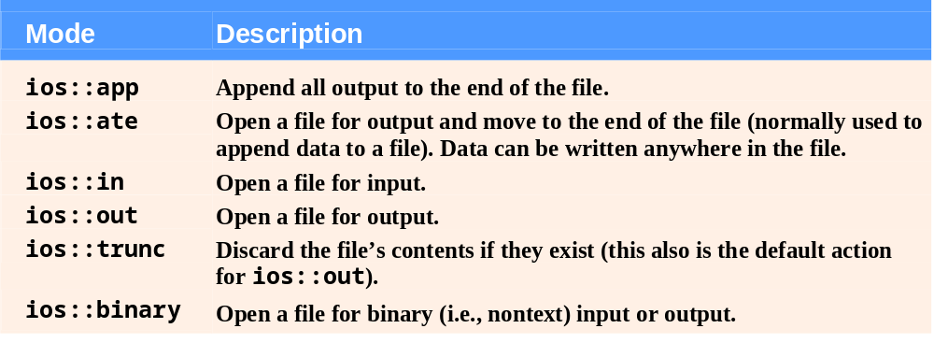
File open modes.

Slide 27
Common Programming Error
Not opening a file either with the ofstream constructor or the open function before attempting to reference it in a program will result in an error.

Slide 28
Sequential Files: The Basics
Step 4: Use the file
  Once the file is open it can be accessed through a file stream object so it is ready to be used
  When data is written to a file it is copied from variables into the file
  When data is read from a file it is copied from the file into variables
  Remember when a program is actively working with data the data is located in RAM, usually in variables, so working with file data is no different

Slide 29
Sequential Files: The Basics
Step 4 cont: Use the file – Writing Information to a File
  You used the stream insertion operator << with cout to write information to the screen (this is because of the class hierarchy we looked at earlier!)
  This same insertion operator can be used with file stream objects to write information to a file
    Example1:
    ofstream outputFile;
    outputFile.open("firstOutputFile.txt");
    outputFile << "This is my first C++ output file\n";
  This looks exactly like a cout statement except that the file stream object name replaces cout
    Example 2 – You can write the contents of variables to files:
    ofstream outputFile;
    outputFile.open("firstOutputFile.txt");
    int x = 5;
    outputFile << "The value in x is: “ << x;
These statements write the stream of information to outputFile exactly as cout would write it to the screen

Slide 30
Sequential Files: The Basics
Step 4 cont.: Use the file – Writing Information to a File – Example #1
  See the example, I added some things to uncomment and practice with
  #include <iostream>
  #include <fstream>
  #using namespace std;
  int main()
  {
  //define an ofstream file stream object named outputFile
  ofstream outputFile;
  //open the file
  outputFile.open("firstOutputFile.txt");
  //write a string to the file
  outputFile << "This is my first C++ output file\n";
  outputFile.close(); //close the file
  return 0;
  }

Slide 31
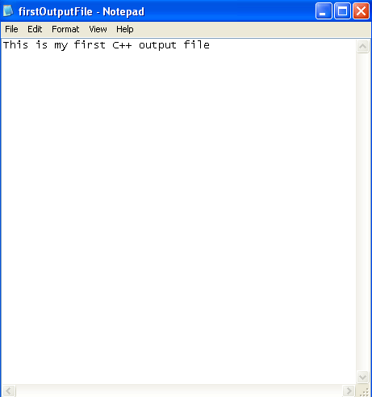
Sequential Files: The Basics
Step 4 cont.: Use the file – Writing Information to a File – Example
  The file that was saved in the same directory as my source code after the program was run

Slide 32
Sequential Files: The Basics
Step 4: Use the file – Writing Information to a File – Example #2
  #include <iostream>
  #include <fstream>
  using namespace std;
  int main()
  {
  //define an ofstream file stream object named outputFile
  ofstream outputFile;
  //open the file
  outputFile.open("favFruits.txt");
  //write three strings to the file, each on a new line
  outputFile << "Strawberries\n";
  outputFile << "Limes\n";
  outputFile << "Grapes\n";
  outputFile.close(); //close the file
  return 0;
  }

Slide 33
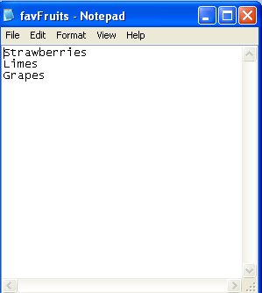
Sequential Files: The Basics
Step 4 cont.: Use the file – Writing Information to a File – Example #2
  Output File Created when Example #2 was run

Slide 34
Sequential Files: The Basics
Step 4 cont.: Use the file – Writing Information to a File
  Output Files have two common uses
    To hold computer program output. When a program writes output to a file instead of a screen, it can be saved for later viewing, modifying and printing
      A report you might want to look at again later
    To hold data generated by one program that will later be read in by another program

Slide 35
Sequential Files: The Basics
Step 4 cont.: Use the file – Writing Information to a File
Let's look at another simple one where we use variables instead of string literals
Example 2a

Slide 36
Sequential Files: The Basics
Step 4 cont.: Use the file – Reading information from the file
  You must use an ifstream object for to read data from a file to variables (or fstream as we'll see later) since ofstream objects only write to files (and ifstream objects only read from files)
    Just like with ofstream objects files associated with ifstream objects must be opened using the constructor or the open member function
      The constructor and member function take two arguments: the file name and the file open mode
      If the file open mode is not specified the default is ios::in
  You used the >> operator to read user input from a cin object
    This operator can also be used to read data from a file
    Assuming inFile is a file stream object that is open and name is a string variable, the following statement shows the >> operator reading data from the file into the variable name
    Remember since ifstream is derived from iostream anything we can do with cin we can do with an ifstream object
      inFile >> name;

Slide 37
Sequential Files: The Basics
Step 4 cont: Use the file – Reading information from the file - Example, reading the favFruits.txt file created in Example #2b – readingFile1.cpp
#include <iostream>
#include <fstream> //needed to use files
using namespace std;
int main()
{
//define an ifstream file stream input object named inputFile
ifstream inputFile;
string fruitName; //to hold fruit names
//open the file
inputFile.open("favFruits.txt");
//read each fruit and print it to the screen using cout
inputFile >> fruitName;
cout << "The first fruit is: " << fruitName << endl;
inputFile >> fruitName;
cout << "The second fruit is: " << fruitName << endl;
inputFile >> fruitName;
cout << "The third fruit is: " << fruitName << endl;
inputFile.close(); //close the file
return 0;
}

Slide 38
Sequential Files: The Basics
Step 4 cont.: Use the file – Reading information from the file
  Example, reading the favFruits.txt file created in Example #2
  Output:
      The first fruit is: Strawberries
      The second fruit is: Limes
      The third fruit is: Grapes
      Press any key to continue . . .

Slide 39
Sequential Files: The Basics
Step 4 cont: Use the file – Reading information from the file
  How Data is Read from a file in this example
    Data is read from file sequentially
    When a file is first opened, the file stream object’s read position is at the first byte of the file
      The first read operation extracts data starting at the first byte
      As data is read the file stream object’s read position advances through the file
    When the >> operator extracts data from a file it expects to read pieces of data that are separated by whitespace characters (newline, spaces, or tabs)

Slide 40
Sequential Files: The Basics
Step 4 cont.: Use the file – Reading information from the file
  How Data is Read from a file
    When the >> operator extracts data from a file it expects to read pieces of data that are separated by whitespace characters (newline, spaces, or tabs)
    In the program that read the names of the fruit from the favFruits file, the following statement read a string from the file:
        inputFile >> fruitName;
      The >> operator extracted a string in this case because fruitName was a string object (you can have a variable of any type there as long as the data read can be saved into that variable)
        Below the first 13 bytes of the file are shown
      The >> operator then extracted all of the characters up to the first whitespace character which in our file was a newline
      After “Strawberries” is extracted the file stream object is positioned so the next read position is the next non-white space character, this makes it so our next string “Limes” can be read next.
S
t
r
a
w
b
e
r
r
i
e
s
\n

Slide 41
Sequential Files: The Basics
Step 4 cont.: Use the file – Reading information from the file
  In the example above, the data of a file created in a previous program was read
  A data file can also be created manually with any text editor to be read in a program
    This is often done when a program has a substantial amount of input

Slide 42
Good Programming Practice 17.1
Open a file for input only (using ios::in) if the file’s contents should not be modified. This prevents unintentional modification of the file’s contents and is an example of the principle of least privilege.

Slide 43
Sequential Files: The Basics
Step 5: Close the file
  The opposite of opening a file is closing it
  All of the example programs have closed the files when they were finished using them
  Although a program’s files are automatically closed when the program is shut down it is good programming practice to write statements that explicitly close the files
    One reason for this is that some operating systems may limit the number of files that may be open at one time.
      Files kept open that are no longer being used use more operating system resources than necessary
    Another reason is that closing a file causes any unsaved information in the file buffer to be saved to its file.
  You close a file by calling the file stream object’s member function close
    outputFile.close();

Slide 44
Performance Tip 17.1
Closing files explicitly when the program no longer needs to reference them can reduce resource usage (especially if the program continues execution after closing the files).

Slide 45
Using File Variable Names
So far we just saw how to specify the names of files to be opened or created by literally coding the file name into our programs
  infile.open("demoFile.txt");
This is fine for student programs but in real life applications cannot require a specific file name, instead they must hold the name of the file the user would like to use
  To do this with the open function a C-String must be used
  Define an array of characters to hold the name of the file, read the name of the file into the array, and then pass the array to the open function like so:
    ifstream inFile;
    char fileName[81]; //80 chars plus null terminator
    cout << "Enter the name of the file:";
    cin.getline(fileName, 81);
    infile.open(fileName);

Slide 46
Using File Variable Names
So far we just saw how to specify the names of files to be opened or created by literally coding the file name into our programs
  infile.open("demoFile.txt");
This is fine for student programs but in real life applications cannot require a specific file name, instead they must hold the name of the file the user would like to use
  NOTE: The open function of file stream objects EXPECTS the name of the file to be a C-String and will not accept C++ string objects. If you already have the name of the file in a C++ string object, you need to use the c_str function or data member function or other data member functions to convert the C++ string to a C String
    ifstream inFile;
    string fileName;
    cout << "Enter the name of the file:";
    getline(cin, fileName);
    infile.open(fileName.data());
Using a string object for the filename has the drawback of requiring the extra step to extract the C String
  However it has the advantage of avoiding possible buffer overflow problems if the name of the file entered by the user is longer than the array can hold
Example 2c
  This is a redo of Example 2b except this time we have the user enter the filename
    For right now we will assume the user enters the right name, we will deal with file open errors later in the lecture

Slide 47
How a program locates files
The name of a file being given to a program can be simple including just the name of the file as in:
  myfile.dat
Or the name of the file can be a full pathname like:
  C:\csc\programs\myfile.dat
The pathname must be specified unless the file is in the current directory, or the default directory in the case of a development environment

Slide 48
Using the fstream object
fstream objects – unlike ifstream and ofstream objects can be used to both read and write file data
  they require the programmer specify whether the object will be used for input, output or both
  This is done through the use of file open modes
  As we discussed the file open mode is an option or flag that the programmer sets to indicate how the file will be used
  Both the open member function and the constructor of file stream objects is overloaded to take a file mode as an optional second parameter
File open modes are predefined values that are members of the ios class (see next slide)
  The ios::in mode is used to set the fstream object for input, and the ios::out mode or ios::app mode is used to set the fstream object for output
  This means we can open a file say, input.dat for input and ouput.dat for output using the fstream object and the appropriate file modes as follows:
    fstream inFile, outFile;
    inFile.open("input.dat", ios::in);
    outFile.open("output.dat", ios::out);

Slide 49
Using the fstream object
It is possible to combine several file open mode flags when a file is being opened
  The combination of flags is achieved through the bitwise or operator, |
  Here is an example of combining file mode flags to open a file for both reading and writing:
      fstream dataFile;
      dataFile.open("myfile.dat", ios::in|ios::out);

Slide 50
Using the fstream object
Reading and Writing files with fstream
File stream objects (fstream objects) have a lot of the same member functions as, and behave similarly to the iostream objects cin and cout
  In particular the insertion operator <<, the extraction operator >> and the library function getline for string objects work in the same way for file stream objects as they do with iostream objects
  In fact, even I/O manipulators work with fstream objects
    Let's look at an example
Look at Example #3
  It opens a file for writing, writes two sentences to it, closes the file and then opens the file for reading, the contents of the file are then printed to the screen

Slide 51
File Open Modes
There are other file modes besides ios::in and ios::out
I showed you the file open modes earlier
  Some file open modes do not make sense with certain file stream objects
    For example, you would not use ios::in with an ofstream object or ios::out with an ifstream object
Certain file stream are open with some of the modes already set by default
  ofstream: The file is opened with a default open mode of ios::out which is for output only (information may only be written to the file but not read from the file).
    If the file does not exist it is created.
    If the file already exists, its contents are deleted (file truncated)
  ifstream: The file is opened with a default open mode of ios::in which is for input only (information may be read from a file but not written to it). The files contents will be read from the beginning.
    If the file does not exist the open operation fails.

Slide 52
File Modes cont.
Many times when a program opens a file for output, the assumption is that no file of that name already exists
  The intention is to create a new file to hold data generated by the program
  This is why the default action in opening a file for output is to delete any existing file of the same name and replace it with a new one
The ios::app file mode can be used if the data already in the file is to be preserved and new data being generated should be added or appended to the end of the file
The ios::noreplace flag specifies that an attempt to open a file for output should fail if the file already exists, this protects important files from deletion and modification
Let's look at Example 4
  This illustrates the use of the ios::app file mode
  If opens a file, writes two names to a file and closes the file
  It then re-opens the file in append mode, adds two more names, closes the file and then terminates
    Let's see what happens if we reopen and don't use ios:app

Slide 53
File Mode Flags
ios::app - Append mode. If the file already exists, its contents are preserved and all output is written to the end of the file. By default this flag causes the file to be created if it doesn't exist
ios::ate – If the file already exists, the program goes directly to the end of it. Output may be written anywhere in the file.
ios::binary – Binary mode. When a file is opened in binary mode, information is written to it or read from it in pure binary format. (The default mode is text)
ios::in – Input mode. Information will be read from the file. By default the file's contents will be deleted if it already exists
ios::out – Output mode. Information will be written to the file. By default, the file's contents will be deleted if it already exists
ios::trunc – If the file already exists, its contents will be deleted (truncated). This is the default mode used by ios:: out
ios::noreplace – Specifies an attempt to open a file for output should fail if the file already exists

Slide 54
File Stream Constructors
The ifsream, ofstream and fstream classes all have constructors that take the name of a file as well as an optional set of file mode option strings and then automatically open the file
The constructors eliminate the need for a separate function call to the open member function
Here are some examples:
  ifstream infile("names.dat");
  fstream iofile("names.dat", ios::in | ios::out);

Slide 55
Testing for File Operation Errors
A call to open a file with the open member function or the constructor FAILS if the filename doesn't exist:
  infile.open("names.dat", ios::in);
  Fails if names.dat does not exist
It's good programming practice to check whether an attempt to open a file was successful before using the file
  This is usually accomplished by testing the value of the stream object immediately after the call to open the file (or after the call to the constructor if the file is being opened with a call to the constructor)
  The value of the stream object will be false (zero) if the open failed, so below !infile will be false if the open failed
ios operators (usable with ofstream)
  Operator member function operator!
    Returns true if either the failbit or badbit is set
  Operator member function operator void *
    Converts the stream to a pointer
      The null pointer (0) is returned if either the failbit or badbit is set, otherwise a a pointer with a value is returned

Slide 56
Testing for File Operation Errors
Example code:
  fstream infile("customer.dat", ios::in);
  if(!infile)
  {
  cout << "The file could not be opened" << endl;
  exit(1); //Exit ends the program. The ExitCode is returned to
  //the operating
  //system, similar to returning a value to int main.
  }

Slide 57
Testing for File Operation Errors
In addition to a failed open, attempts to read a file can fail for other hardware related reasons such as if the disk is full or the drive is malfunctioning.
File stream objects have a member function fail which returns true if the I/O operation was not successfully completed
Example:
  infile.open("customer.dat");
  if(infile.fail())
  {
  cout << "The file could not be opened" << endl;
  exit(1);
  }

Slide 58
eof member function
When reading data from a file, it is not necessary to know how many data values there are or when the data ends
  This is because the program can test the file to see whether there are still values to be read or whether the end of file (eof) has been reached
  One way to do this is with the eof member function which can be called for any file stream object reading input
  The eof member function returns true if the previous read encountered the end of the file, otherwise it returns false
Let's look at Example 5
  uses a loop to keep reading a file until we reach the end of that file
  The eof function does not return true, even if a file is empty until the end of file is detected while attempting to do a read, so one read must be attempted, that is why the first read in the example is before the start of the loop

Slide 59
eof member function
Potential Problems with eof member function:
  For it to work correctly there must be a whitespace (tab, space, enter) in the file after the last data value
    Otherwise, the eof function will return true when the last value is read rather than when no more values exist to be read and the last value will never be processed, let's see what happens if I take the space out after the 12 in the last example
A better way to determine if data is left in the file is to attempt a read and then call the fail function to see if the read was successful
string filename;
cout << "Enter the name of the file:";
getline(cin, filename);
ifstream file(filename.c_str());
if(file.fail())
{
cout << "Cannot open file" << endl;
exit(1);
}
cout << "Contents of the file are: ";
cout << endl;
int number;
file >> number;
while(!file.fail())
{
cout << number << " ";
file >> number;
}
Note that the eof function can reliably be used to test for the end of binary data files because there are no whitespace separators in those types of files (we'll discuss those types of files later)

Slide 60
Output Formatting
Concept: Output formatting works in the same way on all output stream objects
Output formatting for files works in the same way with file stream objects as it does with the cout object (and all ostream objects)
This means all the manipulators we learned and used such as setw(n) , fixed, setprecision(n) etc. all work in the same way with output file streams as they do with cout
Example 6
  Demonstrates the use of setw(n) to arrange output being sent to a file into columns

Slide 61
Output Formatting
Some I/O Manipulators:
dec – displays subsequent numbers in decimal format
endl – writes a new line and flushes the output stream
fixed – uses fixed notation for floating point numbers
hex – inputs or outputs in hexadecimal
left – left justifies output
oct – inputs or outputs in octal
right – right justifies output
scientific – uses scientific notation for floating point numbers
setfill(ch) – makes ch the fill character
setprecision(n) – Sets floating point precision to n (rounds)
setw(n) – sets field width of output to n
showpoint – forces decimal point and trailing zeros to be displayed
noshowpiont – prints now trailing zeros and drops the decimal point if possible
showpos – prints a + with non negative numbers
noshowpos – prints no + with non negative nubmers

Slide 62
Output Formatting
When a program writes data to an open file, the data does not go directly to the file
  Instead it is stored in an output buffer associated with the file and is later transferred to the file in a process known as flushing the buffer
  Usually the buffer is only flushed if it is full or when the file is closed
The endl and flush manipulators allow the programmer to flush the buffer at any time forcing the transfer of the buffered data to the file
Example:
  dataOut << flush;

Slide 63
Output Formatting w/Member Functions
Stream manipulators are not the only way to format data
  Field width, precision and the various format flags of the fstream class may also be modified by using the member functions of the stream objects
  For example, the display field width of an output stream dataOut can be set with the width member function:
    dataOut.width(n);
    This is equivalent to: dataOut << setw(n);
    There are various functions for corresponding manipulators.
  Also there is a function called setf that can by used to do the job done by the manipulator flags, it is just passed a flag that is a value defined in the ios class.
    For example: dataOut.setf(ios::fixed);
    This is equivalent to: dataOut << fixed;
  Multiple flags can be set with a single call to setf by combining them using the bitwise or operator, |
    dataOut.setf(ios::fixed | ios::showpoint | ios::left);
  Format flags can be turned off with the unsetf function:
    dataOut.unsetf(ios::fixed | ios::left);

Slide 64
Output Formatting w/Member Functions
Some formatting member functions of the fstream class (can be used with fstream objects for output):
  width(n) – sets the display field width
  precision(n) – sets the precision of floating point numbers
  setf() – sets the specified format flags
  unsetf() – disables or turns off the specified format flags

Slide 65
Passing file stream objects to functions
Concept: file stream objects may be passed by reference to functions
When writing actual programs you'll want to created modularized code for handling file operations
  File stream objects may be passed to functions but they must always be passed by reference
  The internal state of file stream objects changes with most every operation, file stream objects must be passed by reference to ensure internal consistency
  bool openFileIn(fstream &file, char *name)
  {
  bool status;
  file.open(name, ios::in);
  if(file.fail())
  {
  status = false;
  }
  else
  {
  status = true;
  }
  return status;
  }
Let's look at Example 7
  Uses the file stream object's fail member function to detect the end of the data in a file

Slide 66
More Detailed Error Testing
Concept: All stream objects have error state bits that indicate the condition of a stream
  So all stream objects contain a set of bits that act as flags, the flags indicate the current state of the stream
Here is a list of the file condition bit flags
  ios::eofbit - set when the end of an input stream is encountered
  ios::failbit – set when an attempted operation has failed
  ios::hardfail – set when an unrecoverable error has occurred
  ios::badbit – set when an invalid operation has been attempted
  ios::goodbit – set when all flags above are not set, indicates that the stream is in good condition

Slide 67
More Detailed Error Testing (cont)
The file condition bit flags listed on the previous slide can be tested by the following fstream member functions (we’ve already done eof() and fail() )
Member functions that report on bit flags
  eof() – Returns true if eofbit flag is set, otherwise returns false
  fail() – Returns true if failbit or hardfail flag is set, otherwise returns false
  bad() – Returns true if badbit flag is set, otherwise returns false
  good() – Returns true if goodbit flag is set, otherwise returns false
  clear() – When called with no arguments clears ALL the above listed flags. Can also be called with a specific flag as an argument

Slide 68
More Detailed Error Testing (cont)
The function showState, shown below, accepts a file stream as a reference for its argument. It shows the state of the file by displaying the values of the eof(), fail(), bad(), and good() member functions
This is in Example 8
  void showState(fstream &file)
  {
  cout << "File Status:\n";
  cout << " eof bit " << file.eof() << endl;
  cout << " fail bit " << file.fail() << endl;
  cout << " bad bit " << file.bad() << endl;
  cout << " good bit " << file.good() << endl;
  file.clear(); //clear any bad bits for next call
  }

Slide 69
Member functions for reading & writing files
Concept: File stream objects have member functions for more specialized file reading and writing
If whitespace characters are part of the information in a file, a problem arises when the file is read by the >> operator
  The >> operator considers whitespace characters as delimiters and does not read them
  So let’s say we had this file:
    Jayne Murphy
    47 Jones Circle
    Almond, NC 28702
Let’s think about how this information would be stored in a file
  Remember the computer just sees this as streams of characters
Now let’s look at Example 9 (problem.cpp)and see the problem with using the >> character for this file

Slide 70
The getline member function
The problem with Example 9 can be solved by using the file stream object’s getline member function
  This function reads a line of information, including whitespace characters up until it reaches a newline character (just like getline from before)
  Here is an example of a function call to getline
    dataFile.getline(str, 81, ‘\n’);
The three arguments work as follows
  1st argument str – this is the name of a character array (C String) or pointer to a section of memory. The information read from the file will be stored here
  2nd argument 81 – This number is one greater than the maximum number of characters to be read. In this example a maximum of 81 characters will be read
  3rd argument ‘\n’ – This is a delimiter character of your choice. If this delimiter is encountered it will cause the function to stop reading before the maximum number of characters
    This argument is optional, ‘\n’ is the default
Let’s look at the other program in the Example 9a folder with is the corrected program for our problem

Slide 71
The getline member function
Sometimes you might want to use a delimiter other than ‘\n’ for a file
Consider a file that contains multiple addresses that is internally formatted like this: (names.txt in Example 10)
  Jayne Murphy$47 Jones Circle$Almond, NC 28702\n
  $Bobbie Smith$217 Halifax Drive$Canton SC 28716\n
  $BillHammet$PO Box 121$Springfield, NC 28357\n$
Think of this as a file containing three records
  A record is a set of complete information about a single item
  Also the records in the file are each made of three fields
    The first field is the person’s name
    The second field is the person’s street address or PO Box
    The third field is the person’s city state and zip cod
  Note that each field ends with a $ character, and each record ends with a ‘\n’ character
Look at Example 10 to see how to read this file using $ as the delimiter
NOTE: You could read lines of inputs as strings instead of an array of chars and then call the getline library function instead of the getline member function
  An advantage of using the getline we used is it allows the user of a delminator other then ‘\n’
  Lets see if we can redo it with strings, see first example
  Example 9b

Slide 72
The get member function
The get member function lets you read a single character from a file.
Example
  inFile.get(ch);
  ch is a char variable, a character will be read from the file and stored in ch
Let’s look at Example 11

Slide 73
The put member function
The put member function writes a single character to the file.
Example:
  outFile.put(ch);
Example 12

Slide 74
Rewinding a File
Sometimes you may want to open a file, process all the data in it, rewind the file back to the beginning and then maybe begin processing it again differently
  Maybe the user wants to search the file for all records of a certain kind and then go back and search the file for all records of a different kind
File stream classes offer a number of different functions that can be used to move around in a file…one is:
  seekg(offset, place);
  This function seeks a certain place in the file, the ‘g’ stands for get and denotes that the function works on an input stream
  The new location in the file to seek is given by two parameters
    The new location is at an offset, offset bytes from place
    The offset parameter is a long integer while place can be one of three values defined in the ios class: ios::beg, ios::cur, and ios::end meaning the starting place may be the beginning of the file, the end of the file or the current place in the file.
  We’ll talk about this more later, for now, let’s see how to move to the beginning of the file:
    seekg(0L, ios::beg);
    This says move 0 bytes relative to the beginning of the file
If you are at the end of a file you must clear the end of file flag before calling this function…so to rewind you will need two statements:
  dataIn.clear();
  dataIn.seekg(0L, ios::beg);
Example 13
  This program creates a file, writes some text to it for reading and then rewinds it to the beginning and reads again.

Slide 75
Multiple Files
Concept: It’s possible to have more than one file open at once in a program
In C++ you open multiple files by declaring multiple stream objects such as:
  ifstream file1, file2, file3;
Sometimes you will need one file open for input and one for output, for example you might want to read one file convert it to uppercase and write the results to a second file
  This type of program is called a filter, filers read the input of one file, change it in some way and write the data out to the second file
    The second file is the modified version of the first file
Example 14
  In file is called hownow.txt
  Out file is called out.txt

